Slide 1
Image Scraping and Classification Project
BY: RAVI SHEKHAR VERMA

Slide 2

Business Problem Framing
Images are one of the major sources of data in the field of data science and AI. This field is making appropriate use of information that can be gathered through images by examining its features and details. We are trying to give you an exposure of how an end to end project is developed in this field.
The idea behind this project is to build a deep learning-based Image Classification model on images that will be scraped from e-commerce portal. This is done to make the model more and more robust.
This task is divided into two phases:
Data Collection
Mode Building

Slide 3
Conceptual Background of the Domain Problem
In this section, the task is provided that we need to scrape images from e-commerce portal, Amazon. The clothing categories used for scraping will be:
Sarees (women)
Trousers (men)
Jeans (men)
We need to scrape images of these 3 categories and build your data from it. That data will be provided as an input to a deep learning problem. We need to scrape minimum 200 images of each categories. There is no maximum limit to the data collection. Since we are free to apply image augmentation techniques to increase the size of our data but make us sure the quality of data is not compromised

Slide 4
Review of Literature
From the dataset I get to know that it is a classification problem and there are three categories which are Sarees, Trousers and Jeans. We have Scrap the images and built the model in deep learning.

Slide 5
Motivation for the Problem Undertaken
Building your own data and perform the task of model building and scraping the images from the online portal from amazone.in. Its was a great experience on working of a type of live project which was this. It’s a very interesting and at the same time problematic to working on a dataset. It was a very challenging project.

Slide 6
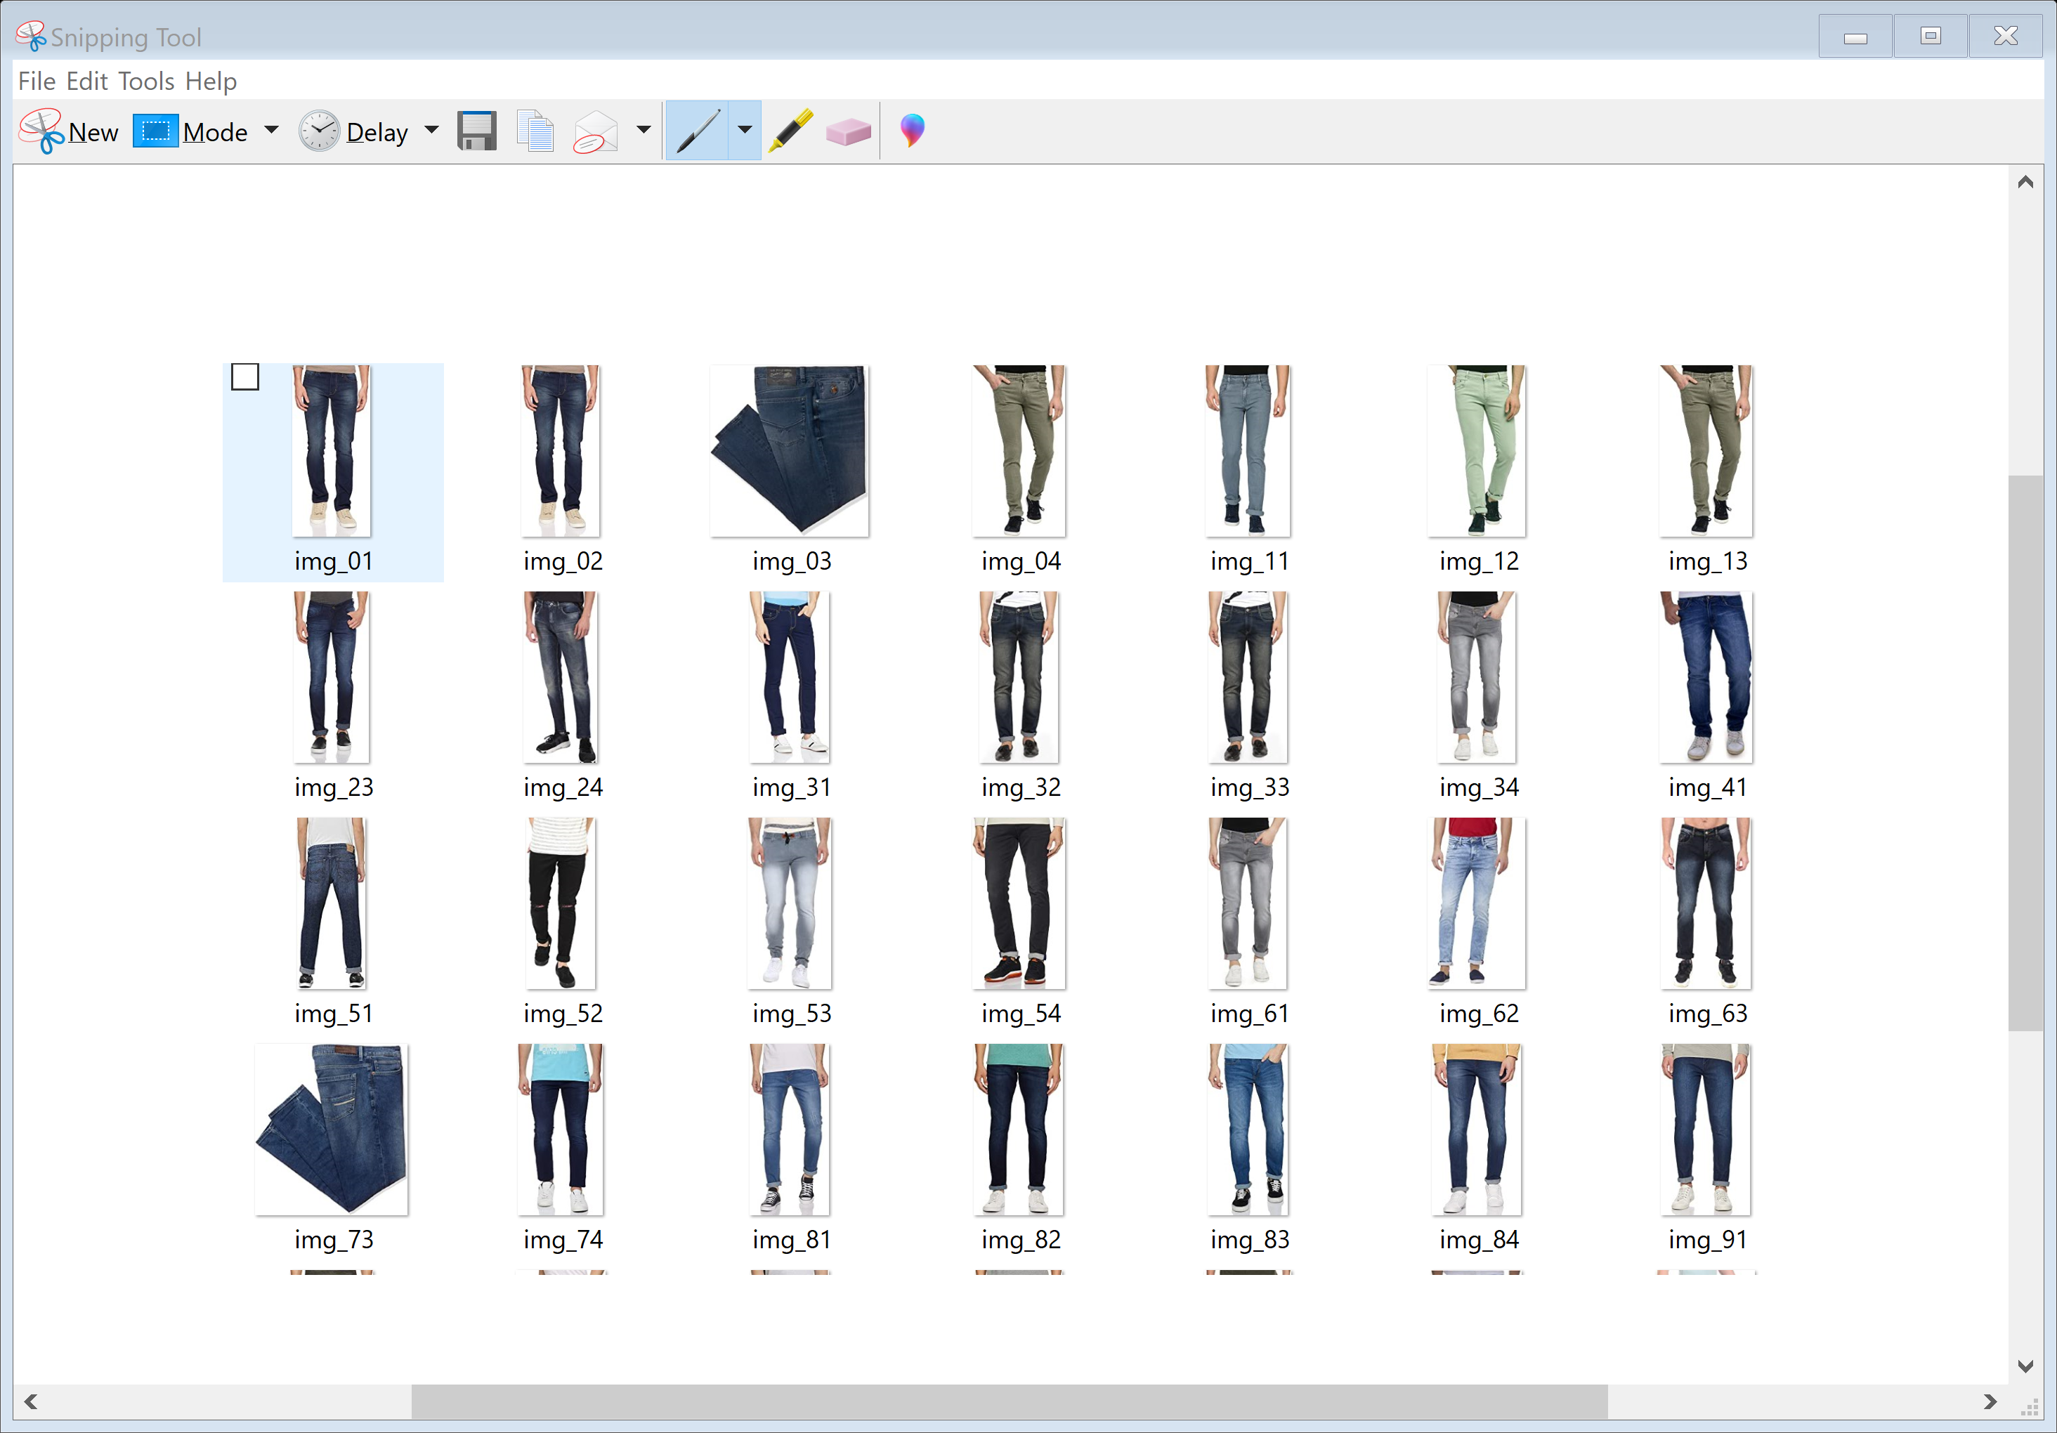
Data Sources and their formats
The above is the Jeans Images which I have scraped and stored in a folder.

Slide 7
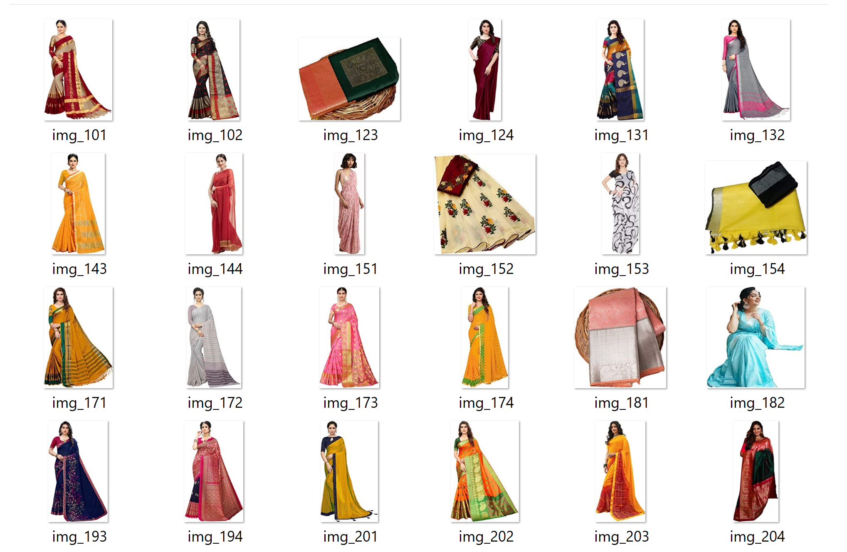
The above is the next categories which is jeans which is also scraped and stored all the images in a folder Sarees

Slide 8
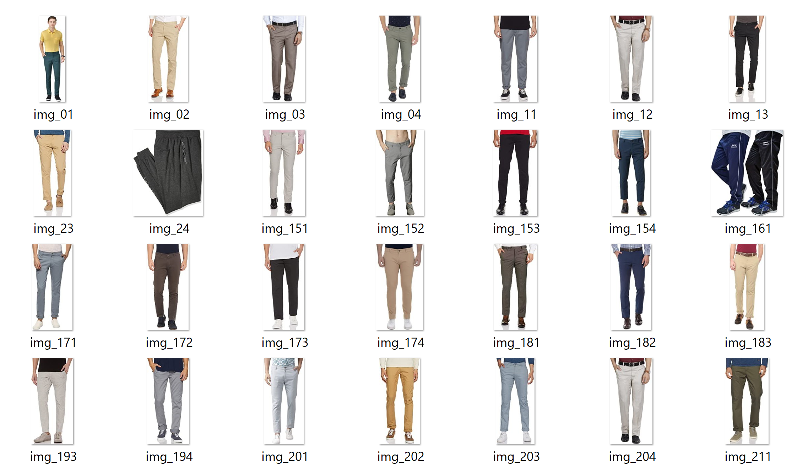
And the last category which is Trousers and the images of trousers are also scraped and stored in a folder.

Slide 9
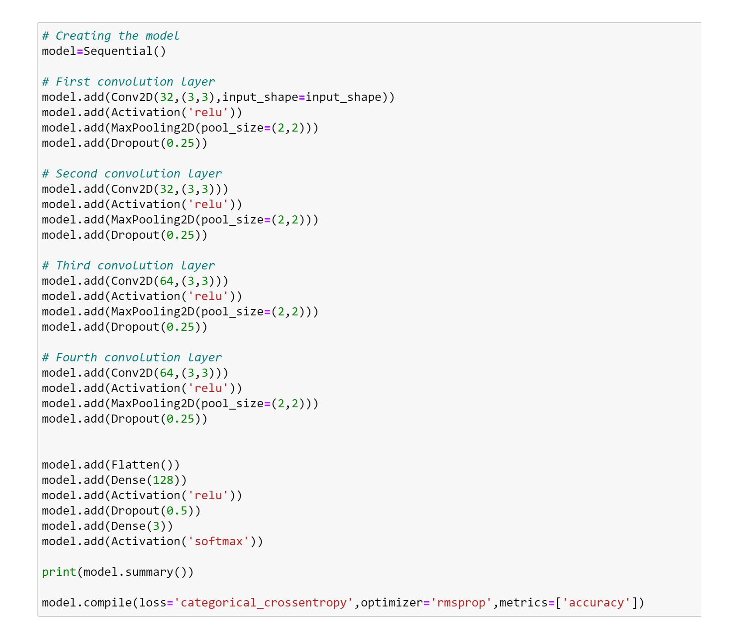
Run and Evaluate selected models

Slide 10
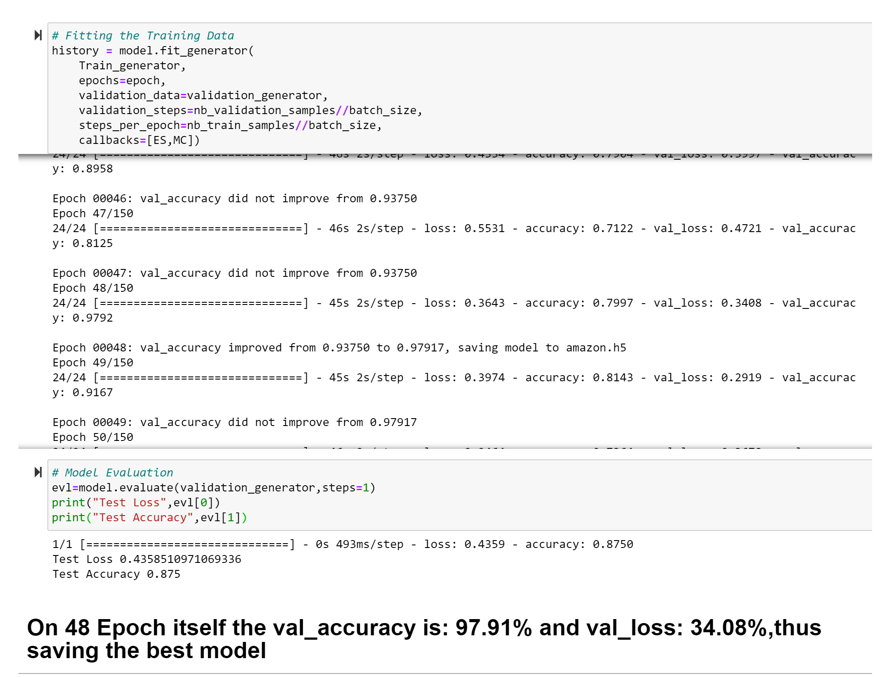
Interpretation of the Results

Slide 11
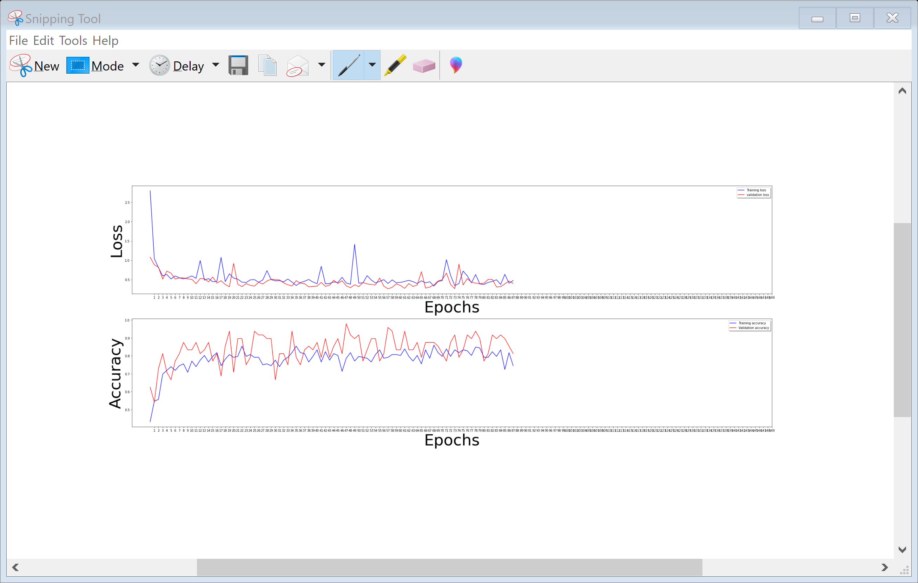
Visualizing Training

Slide 12
Key Findings and Conclusions of the Study
From the dataset which I generated my own through web scraping of the online portal is the finding of sarees jeans and trousers I get to know it is really important to understand the data. I get to know that each feature play a very import role to understand the data. Data format plays a very important role in the visualization and Appling the models and algorithms.

Slide 13
Learning Outcomes of the Study in respect of Data Science
Object detection is a computer vision task that involves both localizing one or more objects within an image and classifying each object in the image.It is a challenging computer vision task that requires both successful object localization in order to locate and draw a bounding box around each object in an image, and object classification to predict the correct class of object that was localized.
Using deep learning convolutional neural networks. While the dataset is effectively solved, it can be used as the basis for learning and practicing how to develop, evaluate, and use convolutional deep learning neural networks for image classification from scratch.
This includes how to develop a robust test harness for estimating the performance of the model, how to explore improvements to the model, and how to save the model and later load it to make predictions on new data.

